Slide 1
HAC 08
AWS re:INVENT
Robocar Rally 2017

Slide 3
Overview
Hackathon Agenda
Teams
Race Tracks
Race Rules
Homework

Slide 4
TWO DAY HACKATHON
Sunday and Monday 7am – 12am
See you at 7am tomorrow!

Slide 5
Sunday
Agenda
Monday
Autonomous Car Overview
AWS Integration Overview
Real World Applications
7am day begins
Hacking
12pm Autonomy and the Cloud
Hacking
8pm Duckietown
9pm exhibition races
10pm race begins!

Slide 6
Teams
Talk to your team mates
Understand the skills you have and/or need
Swap with other team if needed
Create a strategy
Find a COOL team name

Slide 7
Track A
Race Tracks
Track B
Use AWS provided cars
Timed laps
Actual race track on Monday night at 10pm
Use your own car
Anything goes… within reason
Exhibition race at 9pm
Please share the tracks: limit driving to 5 minutes at a time

Slide 8
Race Rules
Requirements
Collect and display real-time telemetry
Stream video

Slide 9
Building your RoboCar
Assemble the vehicle
Calibrate the DonkeyCar
Create an AWS Deep Learning AMI
Use your own AWS account, we provide $100 in credits
Install Donkey Software on AMI
https://aws.amazon.com/blogs/ai/build-an-autonomous-vehicle-on-aws-and-race-it-at-the-reinvent-robocar-rally/

Slide 10
Driving your RoboCar
Learn how to drive the car
It learns directly from you
Bad driving = Bad autonomous driver
Improve the process for collecting and training
Data is stored in ~/d2/data on RaspberryPi
Model is stored in ~/d2/models on RaspberryPi
RaspberryPi is not suitable for training. Too slow and may overheat
Improve management of the RoboCar
AWS CLI
EC2 SSM Client
https://aws.amazon.com/blogs/ai/build-an-autonomous-vehicle-part-2-driving-your-vehicle/

Slide 11
Connecting to your RoboCar
Configure AWS IoT service
Create DonkeyCar Parts for each sensor
Additional sensors may provide racing benefits
Integrate parts and AWS IoT Service into Donkey Code
https://aws.amazon.com/blogs/ai/building-an-autonomous-vehicle-part-3-connecting-your-autonomous-vehicle/

Slide 12
Training your RoboCar
Understand the inner workings of the model
https://aws.amazon.com/blogs/ai/building-an-autonomous-vehicle-part-4-using-behavioral-cloning-with-apache-mxnet-for-your-self-driving-car/

Slide 13
Components
So what's in the kit?

Slide 14
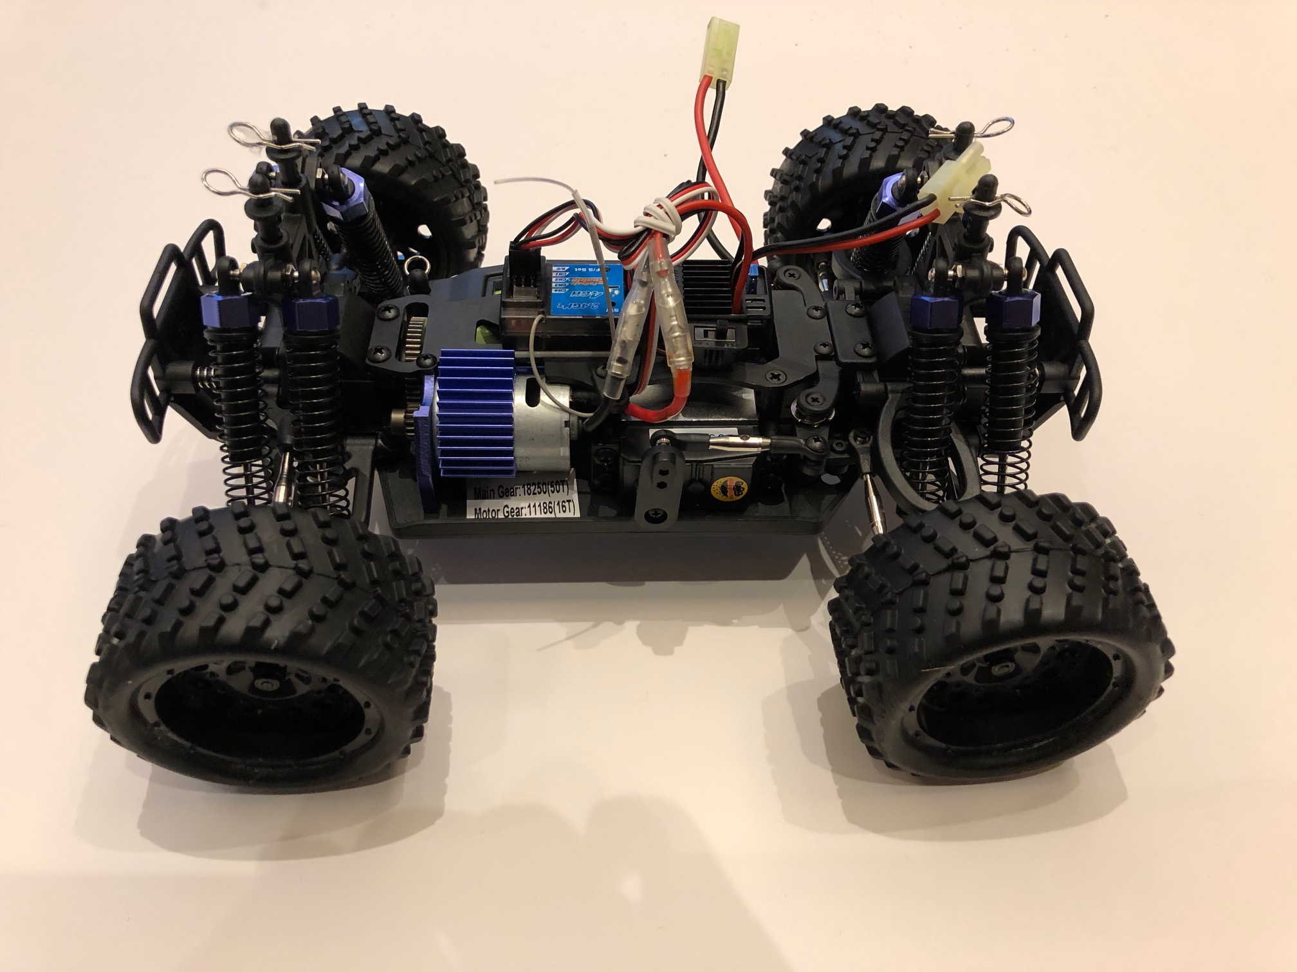
Vehicle

Slide 15
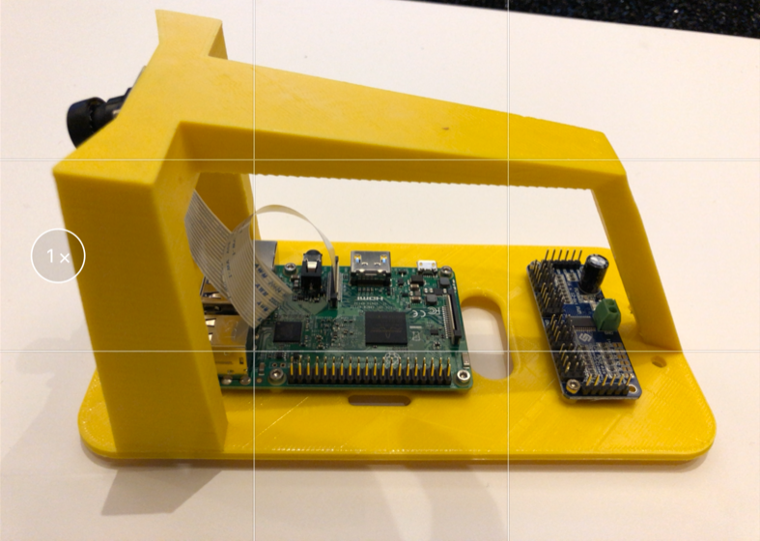
RaspberryPi, Wide Angle Camera, Servo Driver

Slide 16
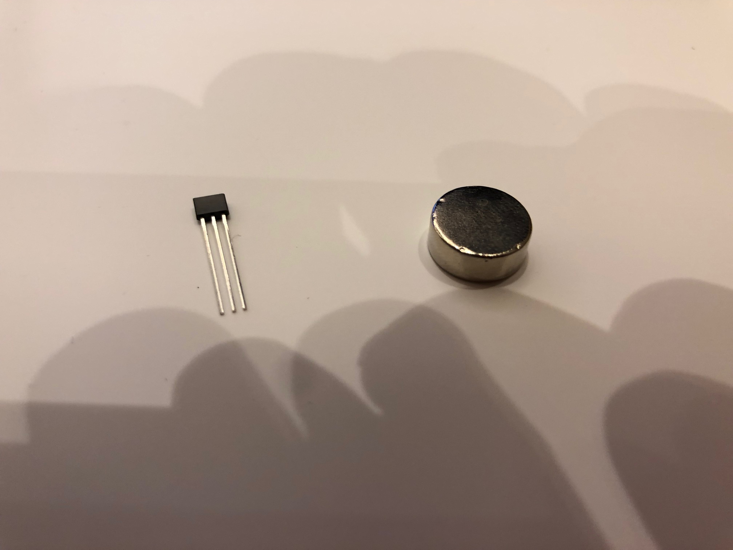
Hall effect sensors and magnets

Slide 17
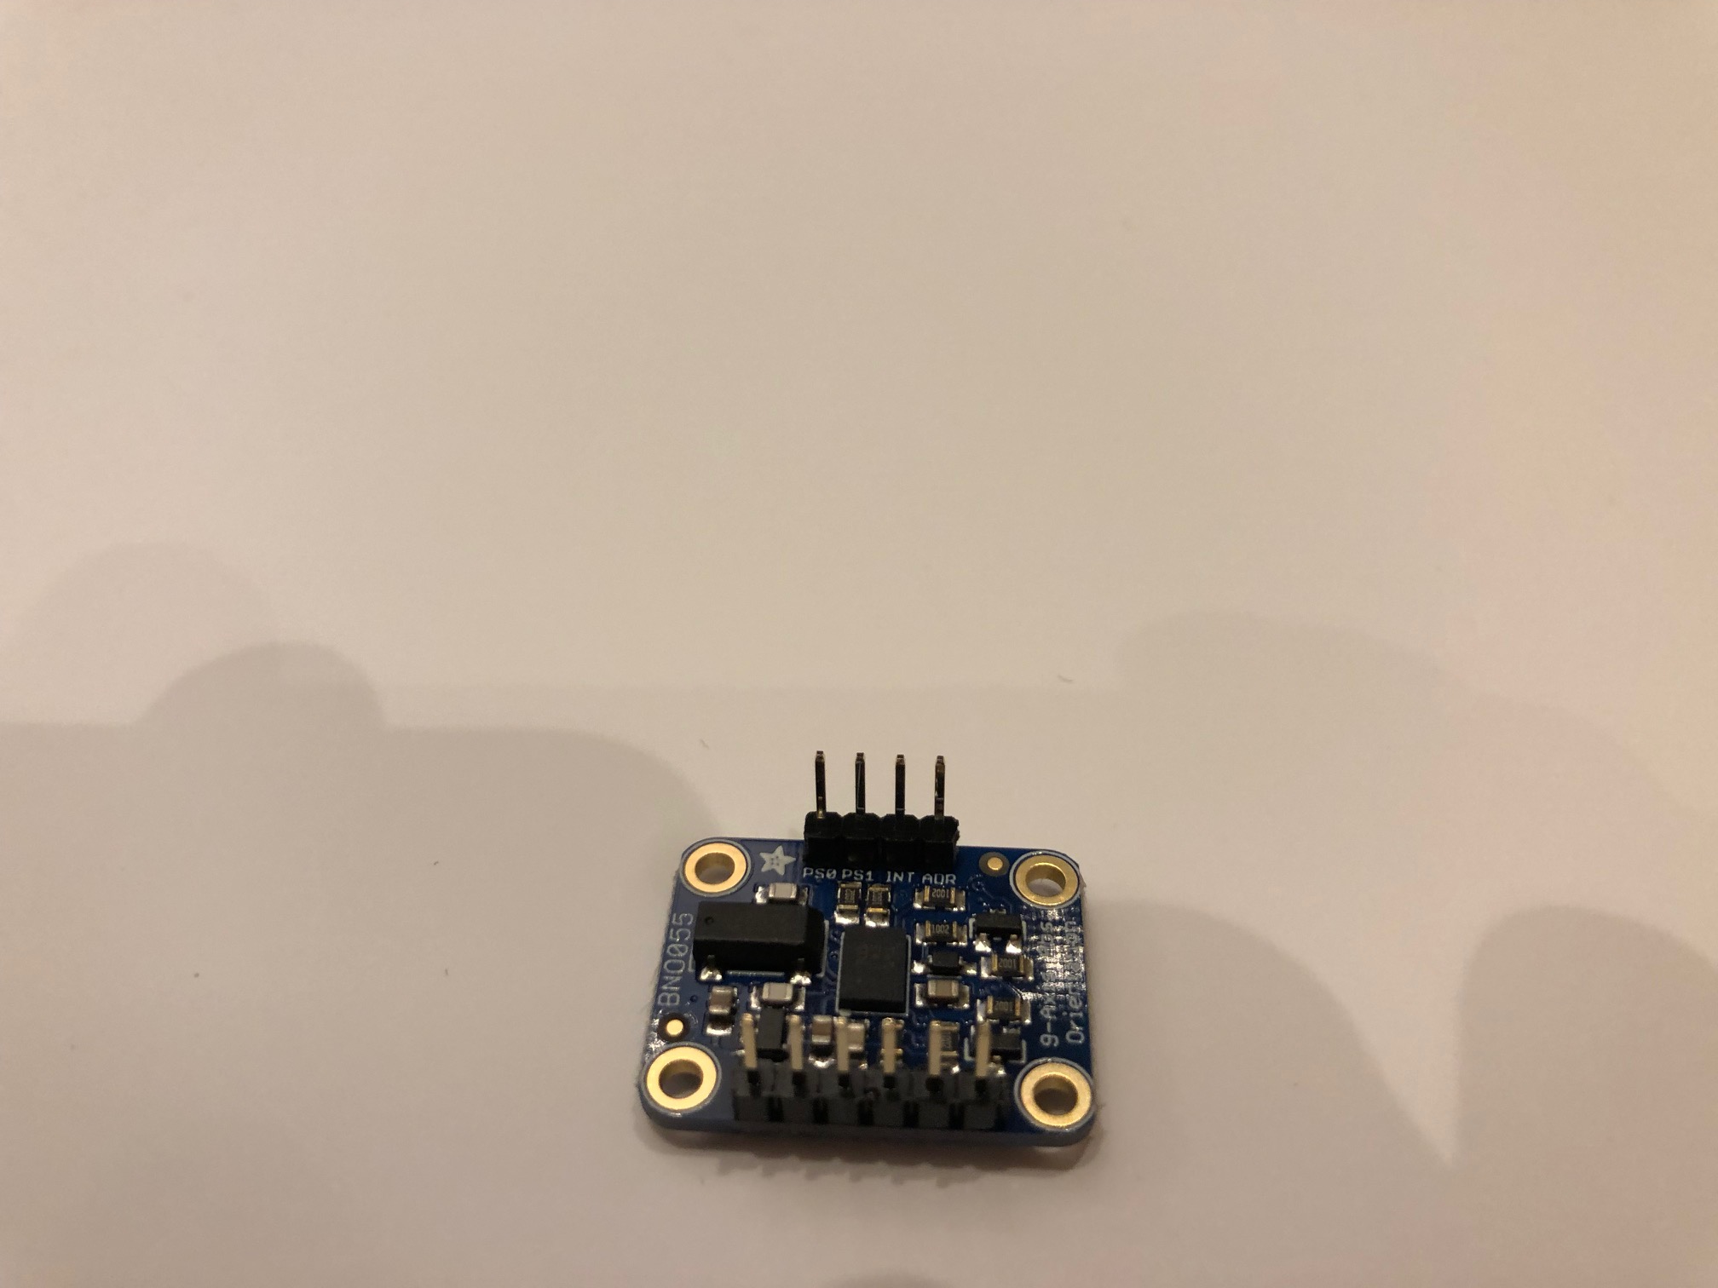
Gyro + Accelerometer

Slide 18
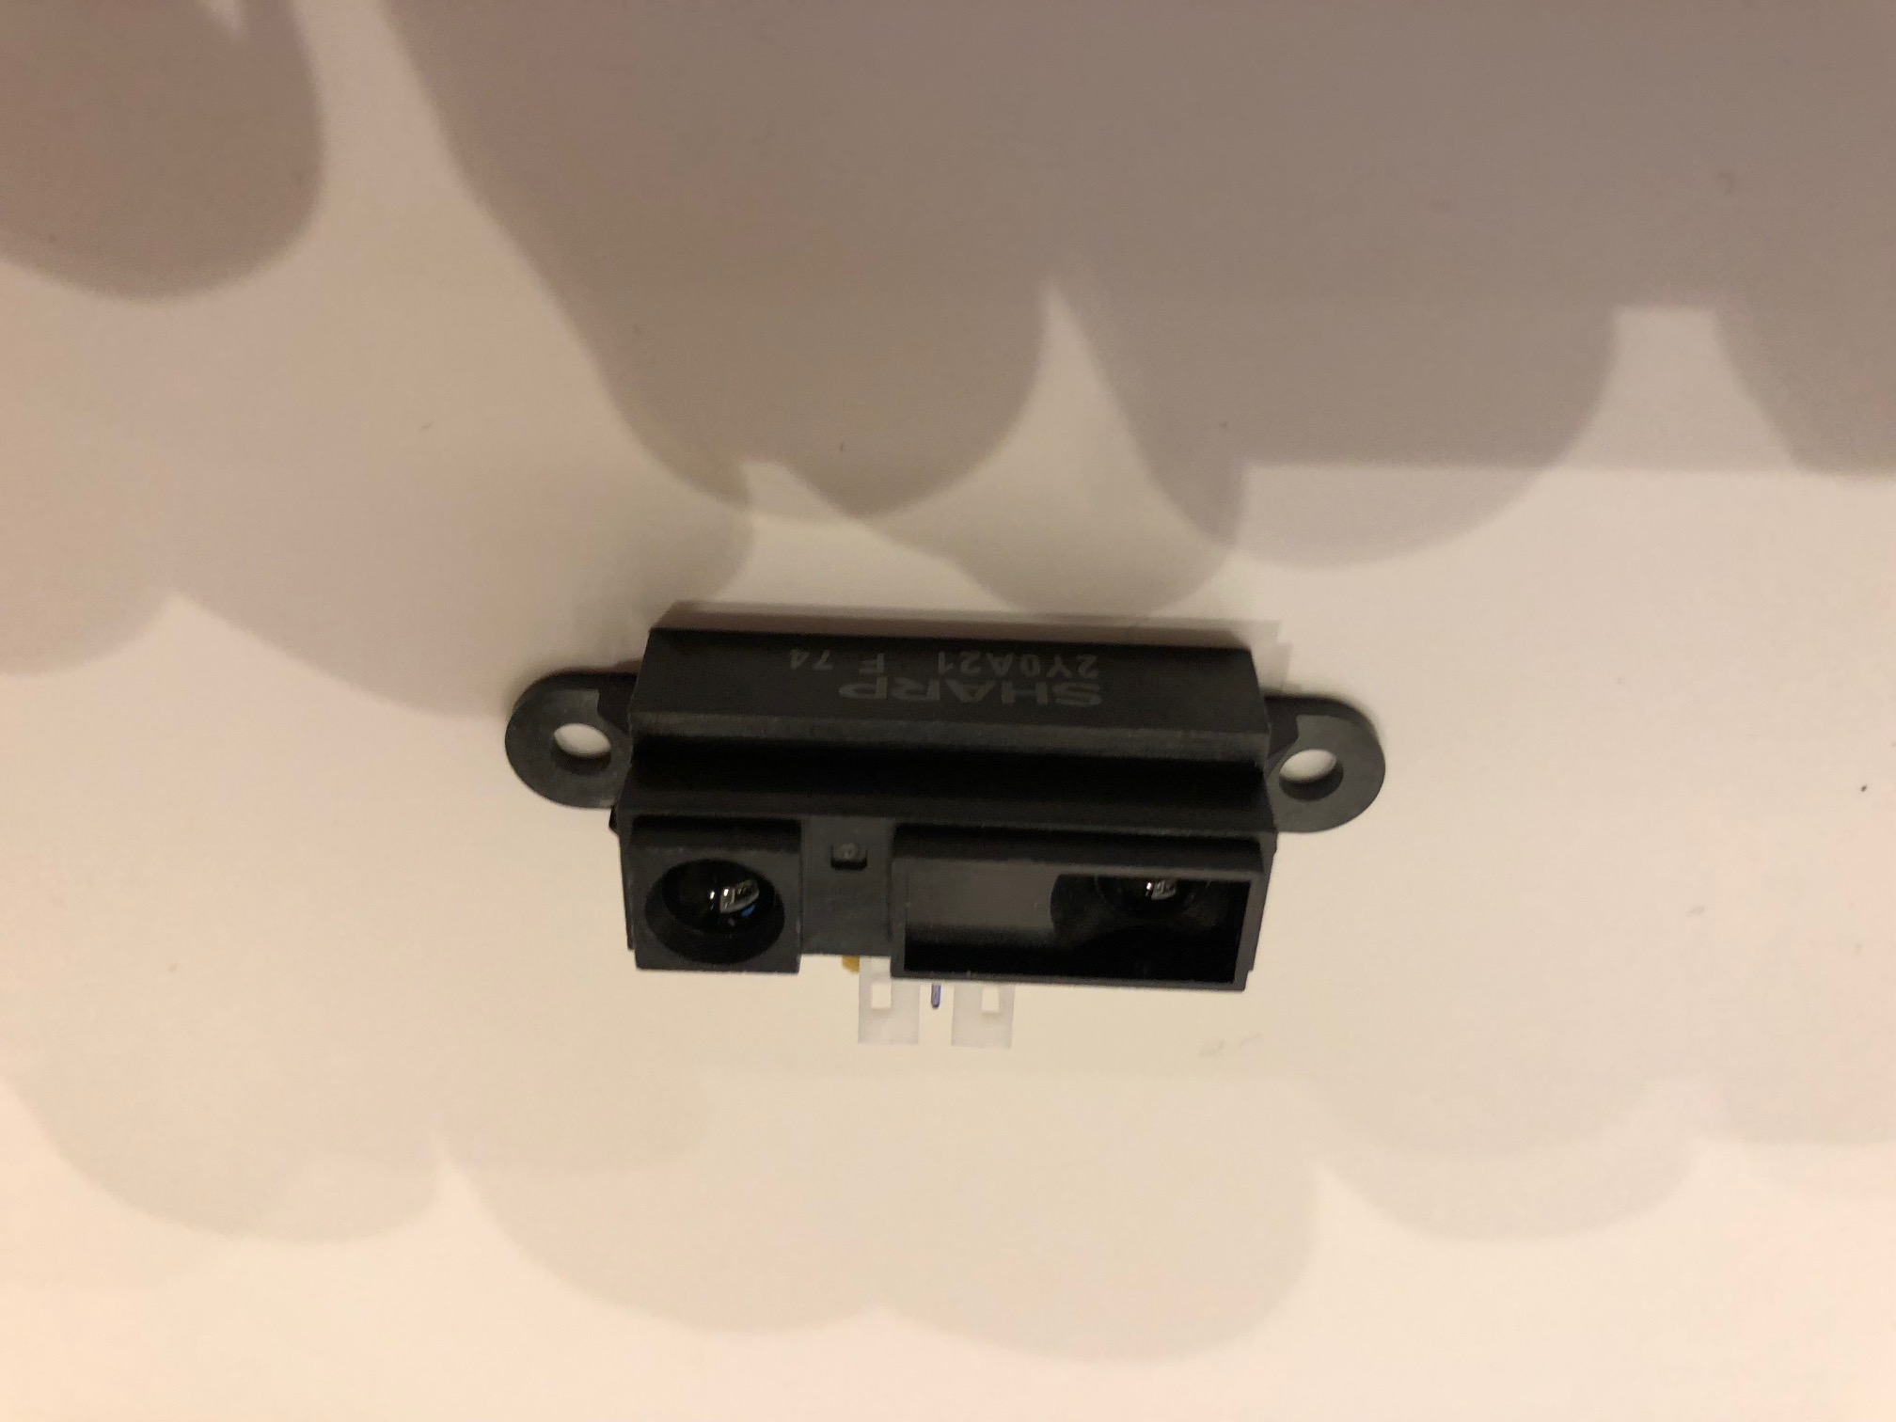
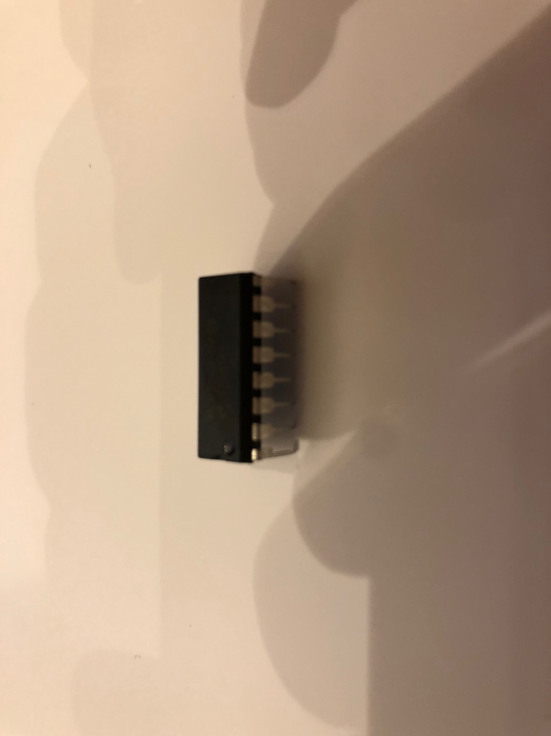
IR Sensor + Analog Converter

Slide 19
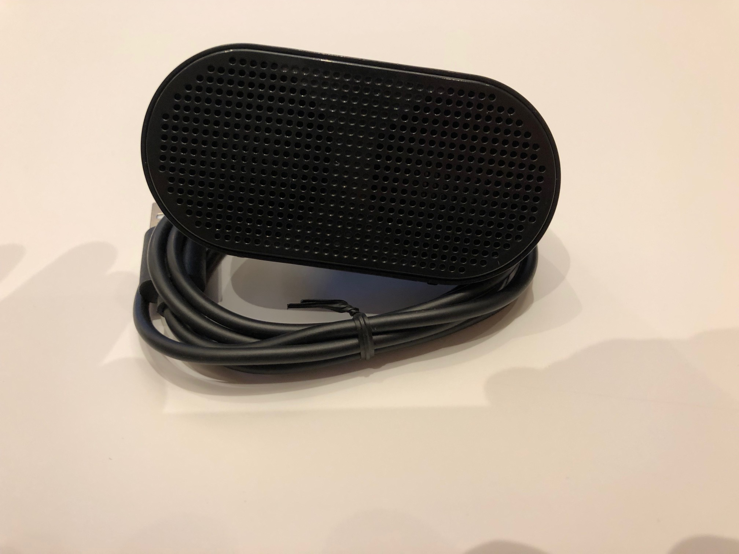
Speakers

Slide 20
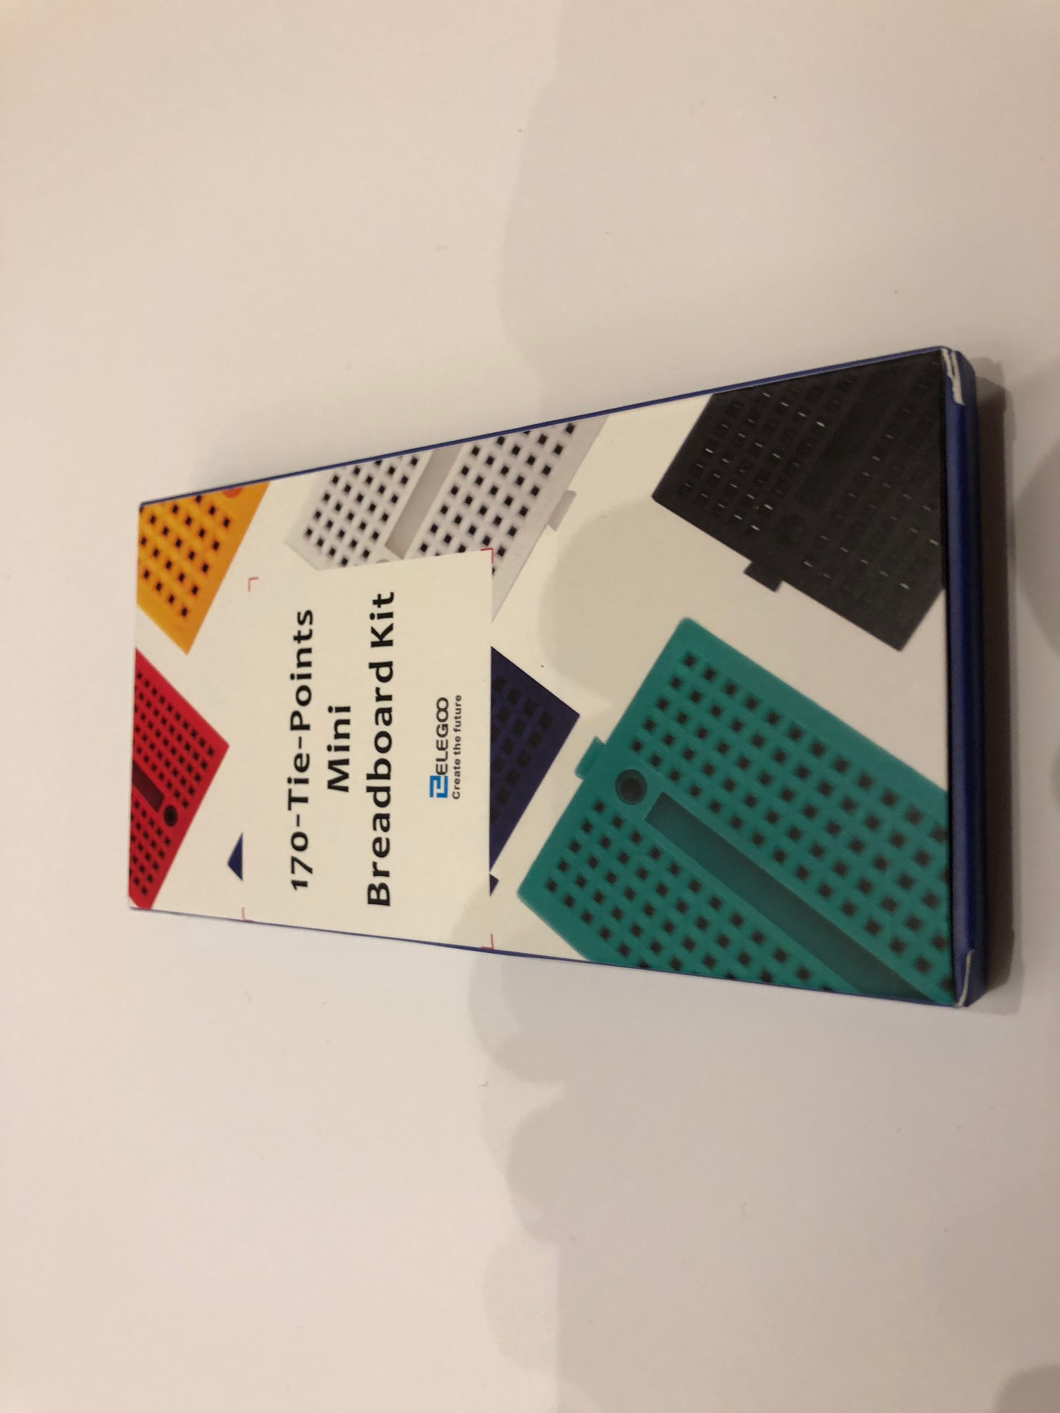
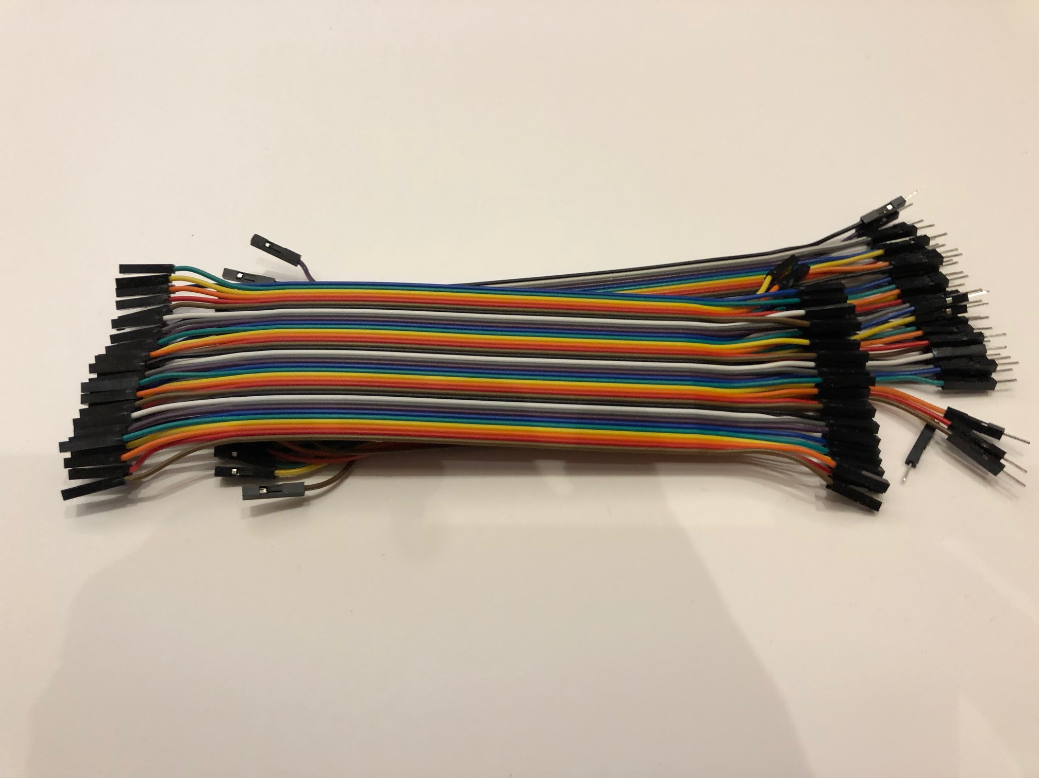
Breadboard and wires

Slide 21
Innovate
Implement Object detection
CI/CD for training and implementing models
Optimize training for large datasets
Implement simulator to supplement track time
Incorporate sensors to provide more training data

Slide 22
Final Thoughts
Friendly competition
Please don’t hack other teams vehicles
Please be mindful of other cars/people on the track
Respect a safe driving distance while training to avoid spoiling data
Password is asdfasdf
Limited battery capacity (ABC) Always Be Charging
Github repo https://github.com/aws-samples/robocarrally

Slide 23
Information
Github repo https://github.com/aws-samples/robocarrally
http://bit.ly/RobocarRallyBlog
http://bit.ly/RobocarRallyTwitch
http://bit.ly/RobocarRallyRepo
http://bit.ly/RoboCarRallyTips
Join the slack channel donkeycar.slack.com

Slide 24
Homework
http://bit.ly/RobocarRallyBlog
http://bit.ly/RobocarRallyTwitch
http://bit.ly/RobocarRallyRepo
http://bit.ly/RoboCarRallyTips
Join the slack channel donkeycar.slack.com

Slide 25
Dataset
Use the aws cli to copy this dataset to create your first model
aws s3 cp s3://www.autonomousvehiclesonaws.com/trainingdata/RoboCarRally/ . –recursive
OR
https://s3.amazonaws.com/www.autonomousvehiclesonaws.com/robocartraining.zip

Slide 26

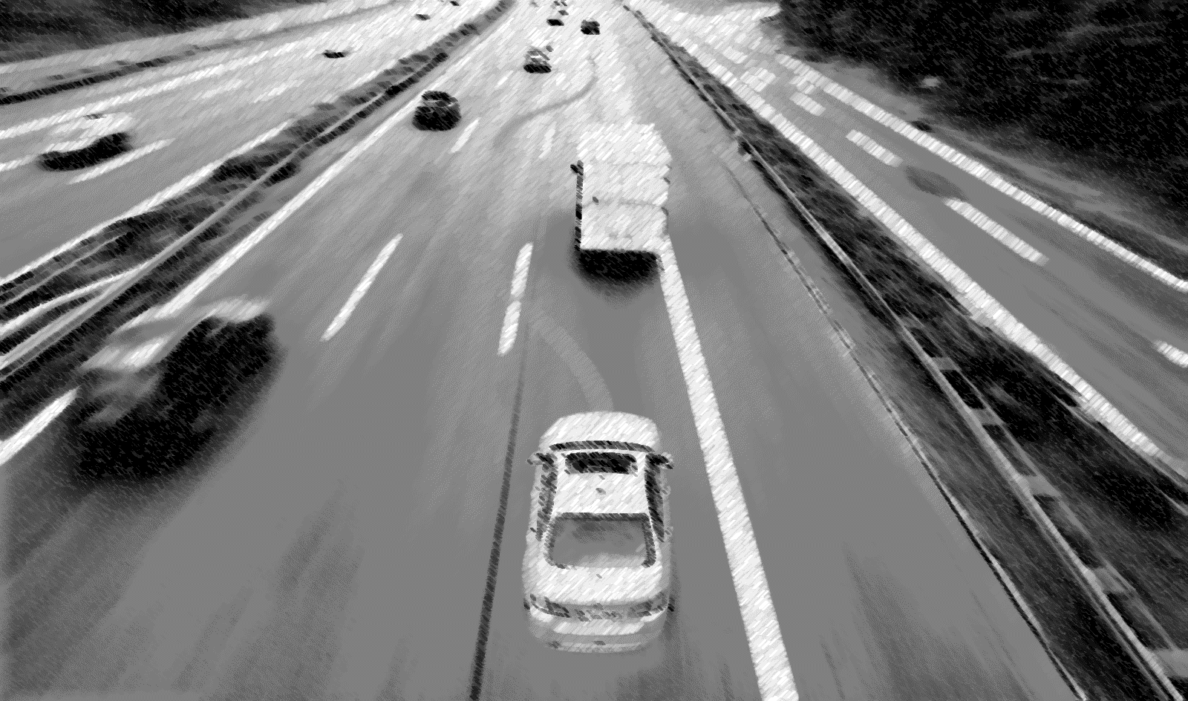
Related Session: Deep Learning for Autonomous Driving
Reinforcement learning is emerging as a powerful tool for autonomous driving, enabling complex maneuvers in a wide range of traffic situations. This session will demonstrate how to build a reinforcement learning engine for autonomous vehicles on AWS, showing how it receives environmental input from object detection and produces outputs for controlling the vehicle’s steering, acceleration and braking.
Session MCL315,
Wednesday November 29 Aria Hotel

